Slide 1
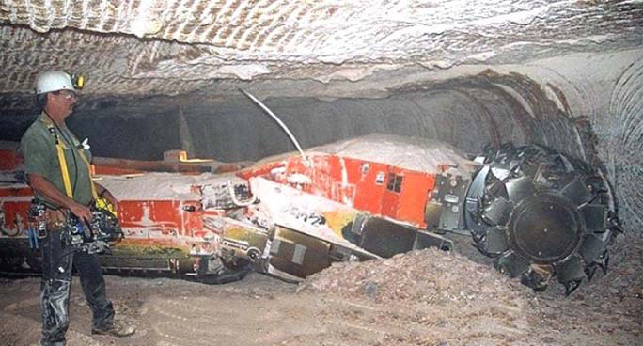
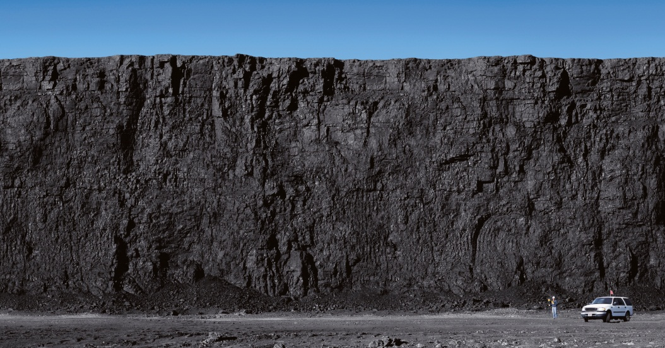
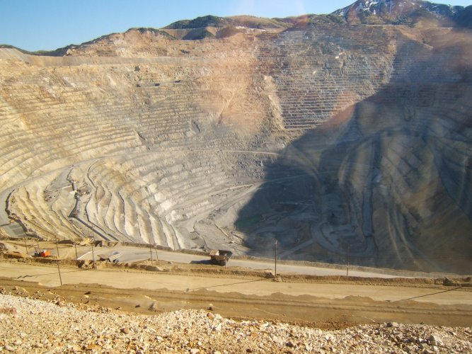
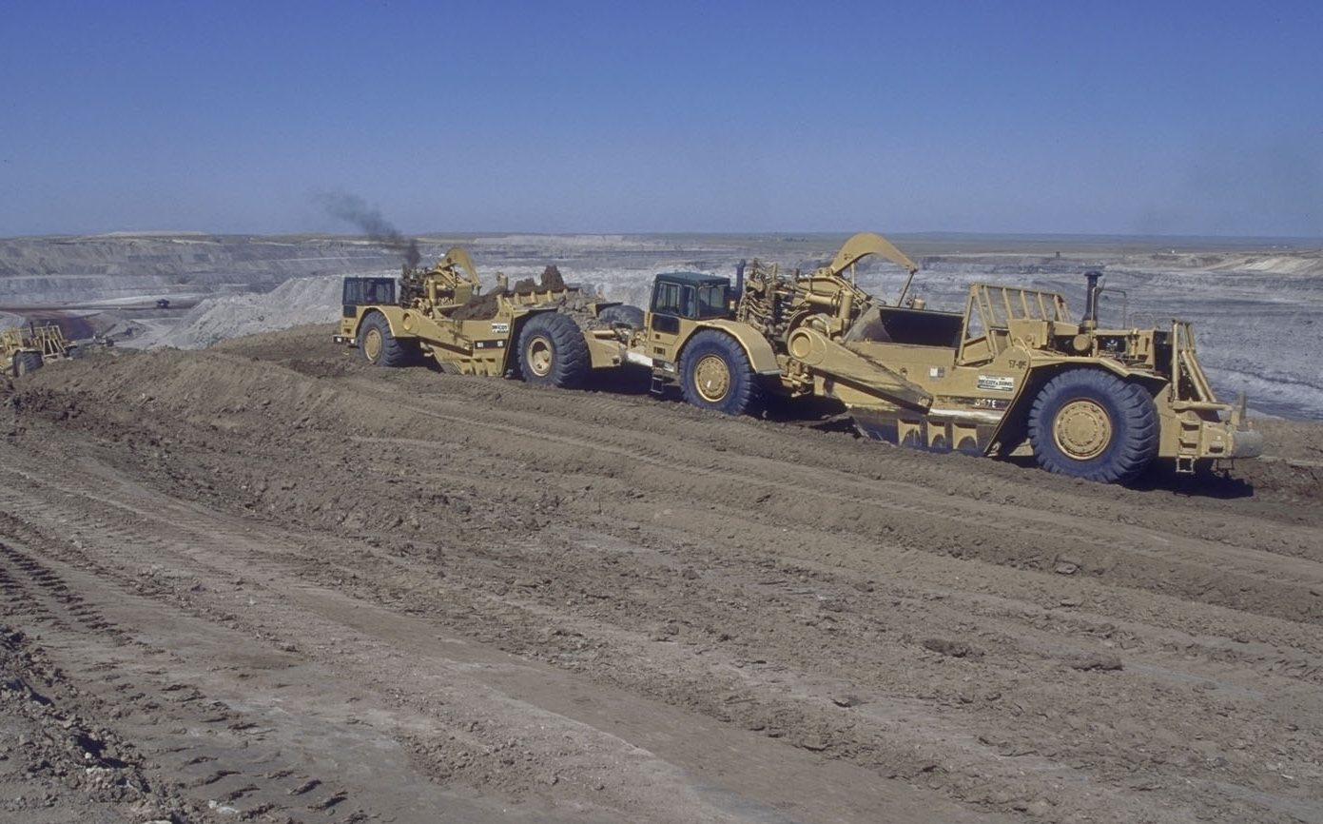
BLM SOLID MINERALS PROGRAM
January 2018
Supporting Text

Slide 2
Bureau of Land Management Federal Onshore Coal
RPC Economics Subcommittee
Onshore Workgroup
January 5, 2018

Slide 3
Solid Minerals Budget (2016 – $ million)
Program | Regulation | Subactivity | Budget | FTE (FY17)
 | (43 CFR) |  | (million $)
Mining Law | 3809 | 1990 | 39.7 | 308
Non-Energy Leasables | 3500 | 1330 | 11.9 | 81
Mineral Materials | 3600 | 1330 | (share of above) | (share of above)
Coal | 3400 | 1320 | 10.87 | 71
Oil Shale – Tar Sands | 3900 | 1310 | -- | --
 |  | Total: | 62.47 | 460

Slide 4
Coal Program

Slide 5
Coal Program Statistics
In the last 10 years (2007-2016*):
BLM produced approximately 4.2 billion tons, worth over $63.4 billion
Production generated $10.68 billion in royalties, rents, bonuses payments
BLM held 27 coal lease sales
Coal generated 42% of the Nation’s electricity
40% of the Nation’s coal was produced from Federal lands
*Full data set by calendar year only available through 2016.

Slide 6
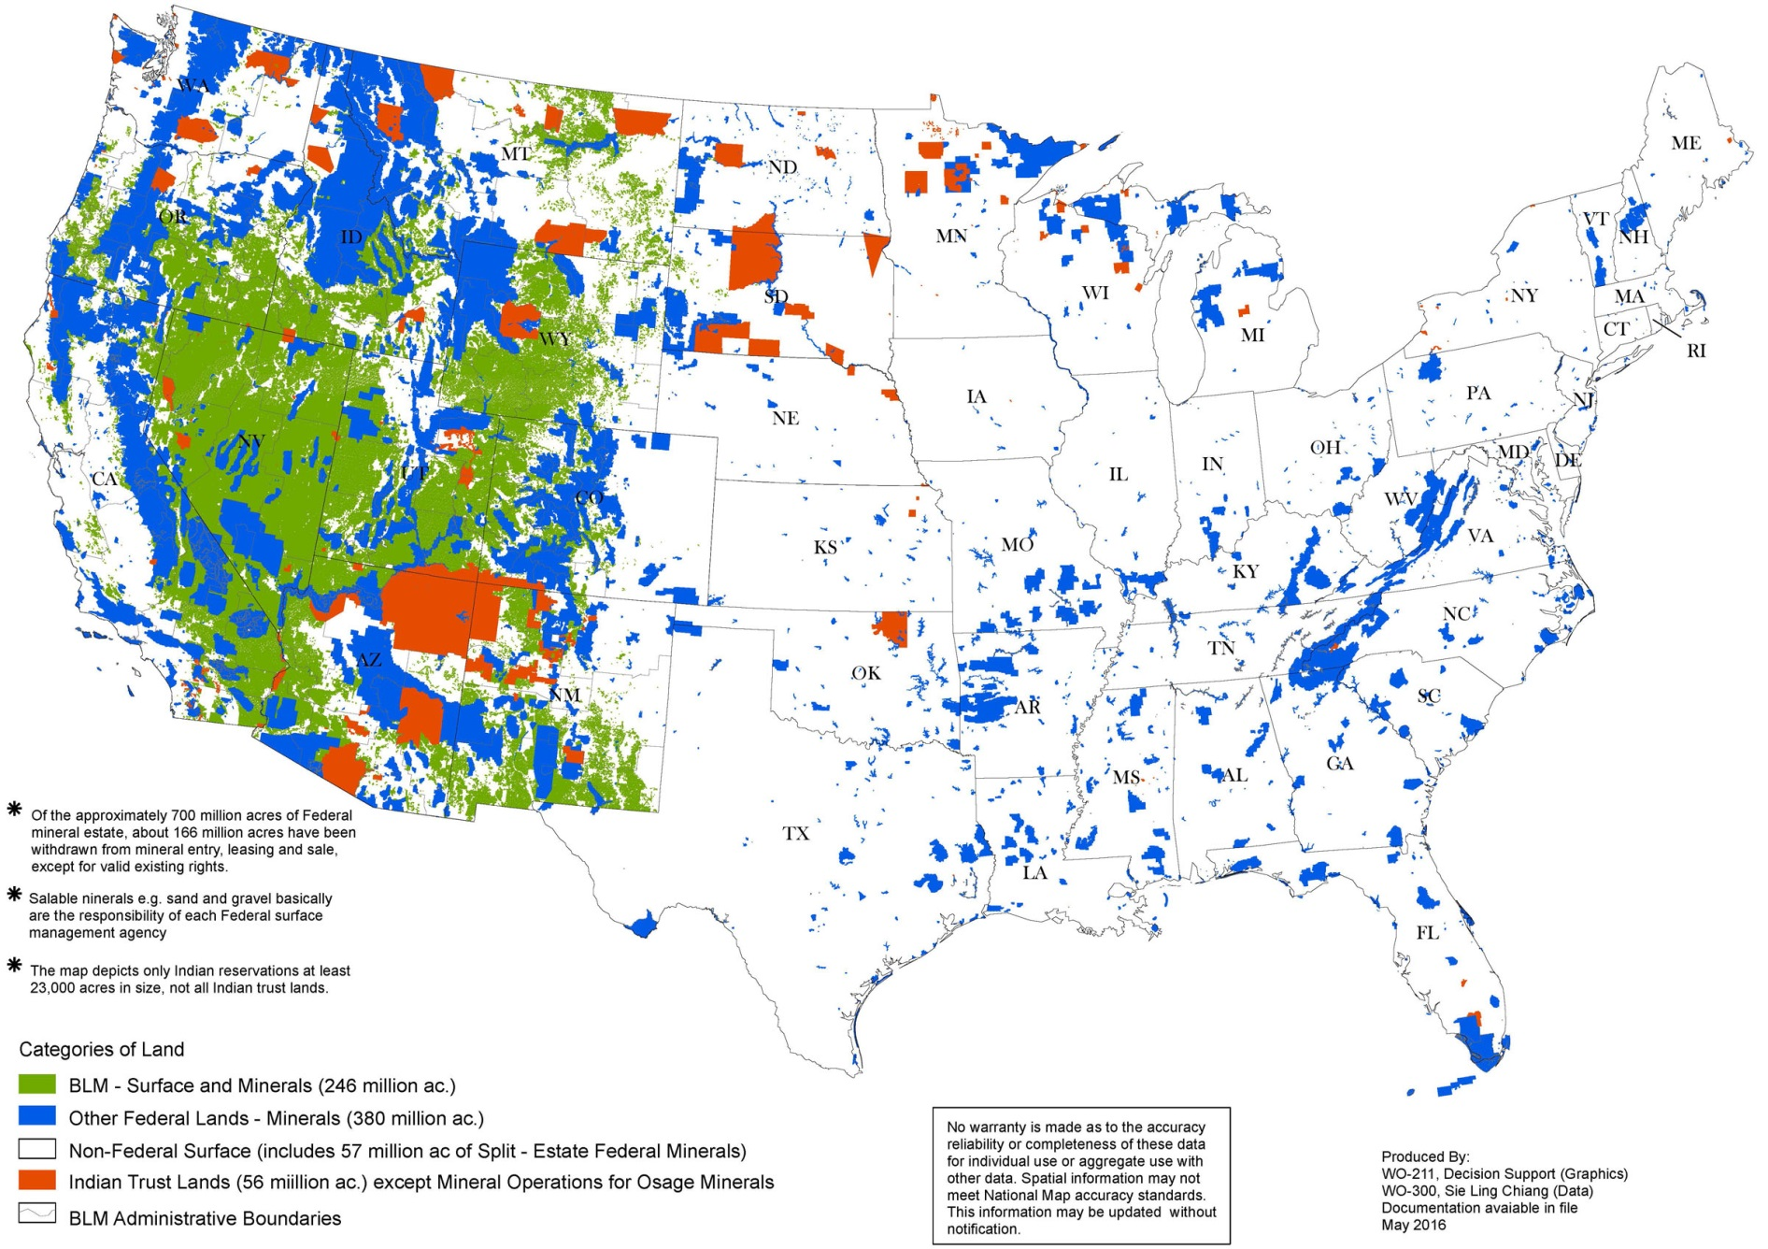
Public Lands, Onshore Federal and
Indian Minerals in Lands of the U.S.
(Lower 48 States)
Notes:
These are the lands that are managed by the BLM
246 million surface acres and 700 million acres of Federal mineral estate (29% of the area of the U.S)

Slide 7
Coal Fields of the Lower-48 United States
Supporting Text
Main Federal Coal Producing Areas
Notes:
The BLM manages public lands and resources in every state across the nation.
The BLM manages one out of every 10 acres of land in the United States.
The public lands managed by the BLM stretch across the nation, from the Arctic Ocean to the Mexican border, and from Key West, Florida to the San Juan Islands of Washington.
The BLM also manages 30% of the nation’s mineral resources, dispersed throughout every state in the country.
Green River, Uintah, Piceance, San Juan basins and Appalachia account for most of the remaining federal coal mined

Slide 8
Coal Leasing Authorities
Mineral Leasing Act of 1920
Federal Coal Leasing Amendments Act of 1976
Federal Land Policy and Management Act of 1976
Surface Mining Control and Reclamation Act (SMCRA) of 1977

Slide 9
General Steps for Federal Coal Leasing and Mining
Land Use Planning
Application Submittal
Environmental Analysis
Mineral Authorization (Right of Entry)
Coal lease sale (bonus bid revenue generated)
SMCRA Permit (Right to Mine)
Granted by Office of Surface Mining, Reclamation and Enforcement (OSMRE) or state
Mining (royalty revenue generated)
Reclamation
OSMRE or state

Slide 10
Federal Coal Leasing Process
Application & Review
NEPA & Fair Market Value
Lease Sale
Issue Lease
Post Lease Bond
Sale Review
Mine permitting (OSM/states)
Mining
Notes:
About one quarter of recent sales have resulted in rejected bids where the high bidder did not meet FMV

Slide 11
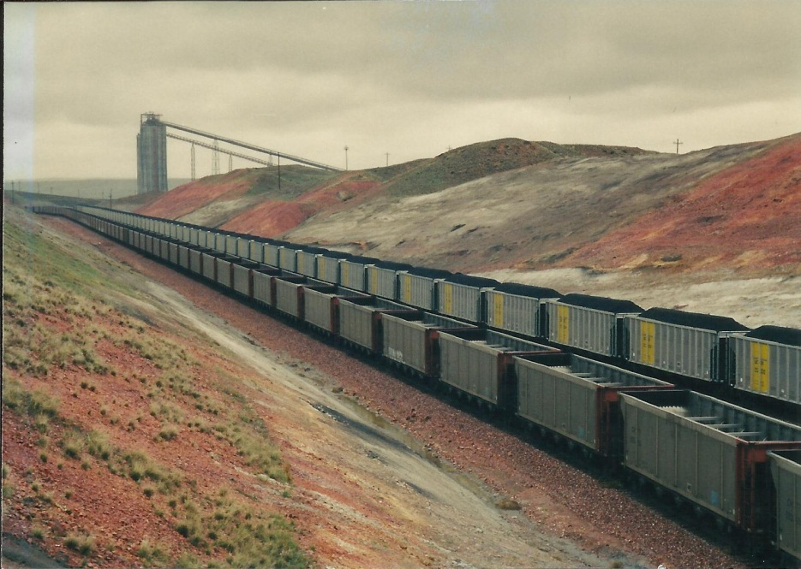
Royalty Requirements for Federal Coal
By statute (30 U.S.C. 207)
Lessees must pay a royalty of not less than 12½% on the sale price of the coal
The Secretary may determine a lesser amount for underground mining operations or where necessary to promote development
By regulation (43 CFR 3473.3-2)
Lessees must pay a royalty of not less than:
12½% for surface mining
8% for underground mining

Slide 12
Bond Administration for Federal Coal Office of Surface Mining, Reclamation and Enforcement
Performance Bonds
OSMRE is responsible for the administration of performance bonds. A performance bond is a surety bond, collateral bond and/or self-bond to assure the permittee performs the requirements of the permit and reclamation plan.
Lease Protection Bonds
OSMRE is responsible for the administration of Federal lessee protection bonds. These bonds hold the permittee responsible for any damages to crops or tangible improvements on Federal lands.
Note: States with OSMRE approved SMCRA regulatory programs may enter into cooperative agreements with OSM in order to become the regulatory authority for coal mining on Federal lands.

Slide 13
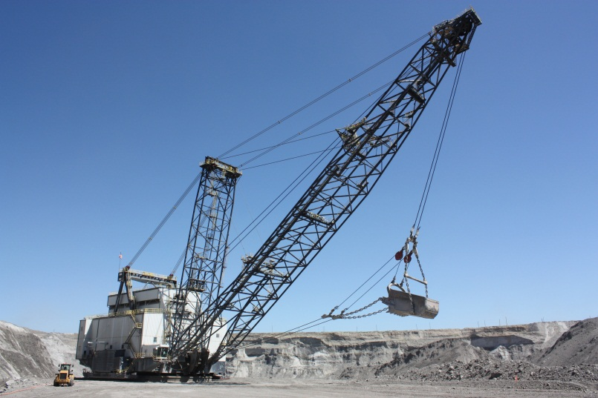
Bond Administration for Federal Coal BLM
Coal Lease Bonds
BLM is responsible for the administration of lease bonds. Lease bonds assure that all aspects of the mining operation other than reclamation operations on a lease are conducted in conformity with the approved mining or exploration plan.
Three months of production royalty One year of lease rental Remaining balance of deferred bonus bids

Slide 14
Fair Market Value (FMV)
BLM establishes pre-sale estimate of the FMV of the lease
Joint BLM and Office of Valuation Services effort
Income Approach
Geologic analysis
Engineering analysis
Market analysis
Valuation
Comparable Sales
Valuation based on recent similar sales
High bid must meet or exceed the pre-sale FMV (serves as a proxy for competition where only one bid is received)

Slide 15
FY 2007-2016 COAL SALE BONUSES $2.8 BILLION BONUS BIDS ACCEPTED 2.1 BILLION TONS LEASED
Federal Coal Lease Sales
Year | No. Sales | Acres Leased | Tons Leased | Bonus Bid | Bonus Bid $/Ton
2008 | 3 | 13,132 | 591,700,000 | $456,650,513 | $0.77
2009 | 3 | 1,066 | 56,618,000 | $48,650,024 | $0.86
2010 | 1 | 160 | 3,000,000 | $16,000 | $0.01
2011 | 4 | 7,441 | 758,549,800 | $701,100,191 | $0.92
2012 | 6 | 15,390 | 1,388,321,336 | $1,551,743,458 | $1.12
2013 | 2 | 3,795 | 30,500,000 | $8,690,000 | $0.29
2014 | 1 | 1,789.20 | 8,020,000 | $2,887,200 | $0.36
2015 | 2 | 10,333.79 | 57,000,000 | $17,975,000 | $0.32
2016 | 0 | 0 | 0 | $0 | $0.00
2017 | 2 | 6,495 | 61,040,000 | $22,882,000 | $0.37
Total | 24 | 59,602 | 2,954,749,136 | $2,810,594,386
Ave/Year | 2.4 | 5,960 | 295,474,914 | $281,059,438.60 | $0.95
Notes:
Coal Bonus is a part of Fair Market Value payment that is paid during competitive bidding process for coal sales. Rent and royalties are known prior to coal sale. The only unknown is the coal bonus and this is the piece of the formula that will determine who will be the high bidder.

Slide 16
FY 2007-2016 COAL ROYALTY PAYMENTS* $6.9 BILLION
Year | Federal Coal Sales / Prod & Funds Collected by ONRR
 | No. of Leases | Federal Tons | Royalty | Gross Value
2007 | 298 | 439,985,972 | $561,549,252 | $5,167,947,075
2008 | 300 | 480,254,684 | $673,981,246 | $6,109,987,638
2009 | 299 | 464,053,787 | $693,890,508 | $6,286,373,318
2010 | 298 | 454,786,120 | $742,693,852 | $6,696,848,110
2011 | 306 | 451,352,837 | $774,117,051 | $6,968,480,607
2012 | 310 | 440,462,104 | $799,306,820 | $7,514,755,104
2013 | 309 | 403,156,634 | $697,439,021 | $6,833,224,670
2014 | 310 | 330,733,336 | $699,641,723 | $6,769,066,050
2015 | 306 | 389,809,296 | $682,701,506 | $6,426,286,155
2016 | 303 | 303,256,915 | $536,456,113 | $4,932,471,529
Total | 3,039 | 4,157,851,685 | $6,861,777,090 | $63,705,440,257
Ave/Year | 304 | 415,785,168 | $686,177,709 | $6,370,544,026
*Revenue from royalty is collected by the Office of Natural Resources Revenue; data for calendar year 2017 not available at this time

Slide 17
Year | Federal Coal Sales / Prod & Funds Collected by ONRR (by Accounting Year)
 | Fed. Tons Mined/Sold | Royalty | Rent | Bonus Collected | Other Revenues *
2007 | 439,985,972 | $561,549,252 | $1,076,054 | $346,435,013 | -$6,433,870
2008 | 480,254,684 | $673,981,246 | $1,322,600 | $435,798,413 | $1,960,659
2009 | 464,053,787 | $693,890,508 | $1,259,813 | $390,821,322 | $13,339,683
2010 | 454,786,120 | $742,693,852 | $1,274,215 | $109,259,487 | $3,565,687
2011 | 451,352,837 | $774,117,051 | $1,420,470 | $175,235,034 | $5,176,944
2012 | 440,462,104 | $799,306,820 | $1,341,477 | $560,597,984 | $3,527,835
2013 | 403,156,634 | $697,439,021 | $1,133,149 | $460,458,002 | $6,036,353
2014 | 330,733,336 | $699,641,723 | $1,296,355 | $450,772,006 | $9,996,425
2015 | 389,809,296 | $682,701,506 | $1,290,319 | $453,868,656 | -$409,569
2016 | 303,256,915 | $536,456,113 | $1,308,571 | $384,065,341 | $667,894
Total | 4,157,851,685 | $6,861,777,090 | $12,723,023 | $3,767,311,257 | $37,428,041
Ave/Year | 415,785,168 | $686,177,709 | $1,272,302 | $376,731,126 | $3,742,804
*Note: ONRR defines Other Revenues as an aggregated of contributions such as adjustments to estimated royalty payments, settlement agreements, interest etc. ONRR data for calendar year 2017 not available at this time

Slide 18
Recent Audits of the U.S. Department of the Interior’s Coal Management Program
The Office of Inspector General (OIG), U.S. Department of the Interior, Final Evaluation Report-Coal Management Program, (CR-EV-BLM-0001-2012), June 11, 2013
http://www.doi.gov/oig/reports/upload/CR-EV-BLM-0001-2012Public.pdf
The U.S. Government Accountability Office (GAO), Coal Leasing: BLM Could Enhance Appraisal Process, More Explicitly Consider Coal Exports, and Provide More Public Information (GAO-14-140): Published: December 18, 2013. Publicly Released: Feb 4, 2014
http://www.gao.gov/products/GAO-14-140
BLM has implemented all corrective actions and has successfully closed both audits

Slide 19
Secretarial Orders 3348 & 3355
SO 3348:
Revoked Secretarial Order 3338 issued by Secretary Jewell, and:
Lifted the coal leasing moratorium
Ended the Coal Leasing Programmatic Environmental impact Statement
SO 3355:
Directed Department bureaus to undertake efforts to streamline the NEPA process, and
Establish page and time limits of NEPA documents (Environmental Assessments and Environmental impact Statements)

Slide 20
Summary
Federal coal plays an important role in the nation’s energy portfolio
The BLM is charged with ensuring these resources are managed responsibly while providing a fair return to the American public
BLM has taken steps to modernize the coal program:
A more robust valuation process
Consideration of export markets
Greater transparency

Slide 21
Questions
?
Tim Spisak, BLM
tspisak@blm.gov
202-208-4201

