Slide 1
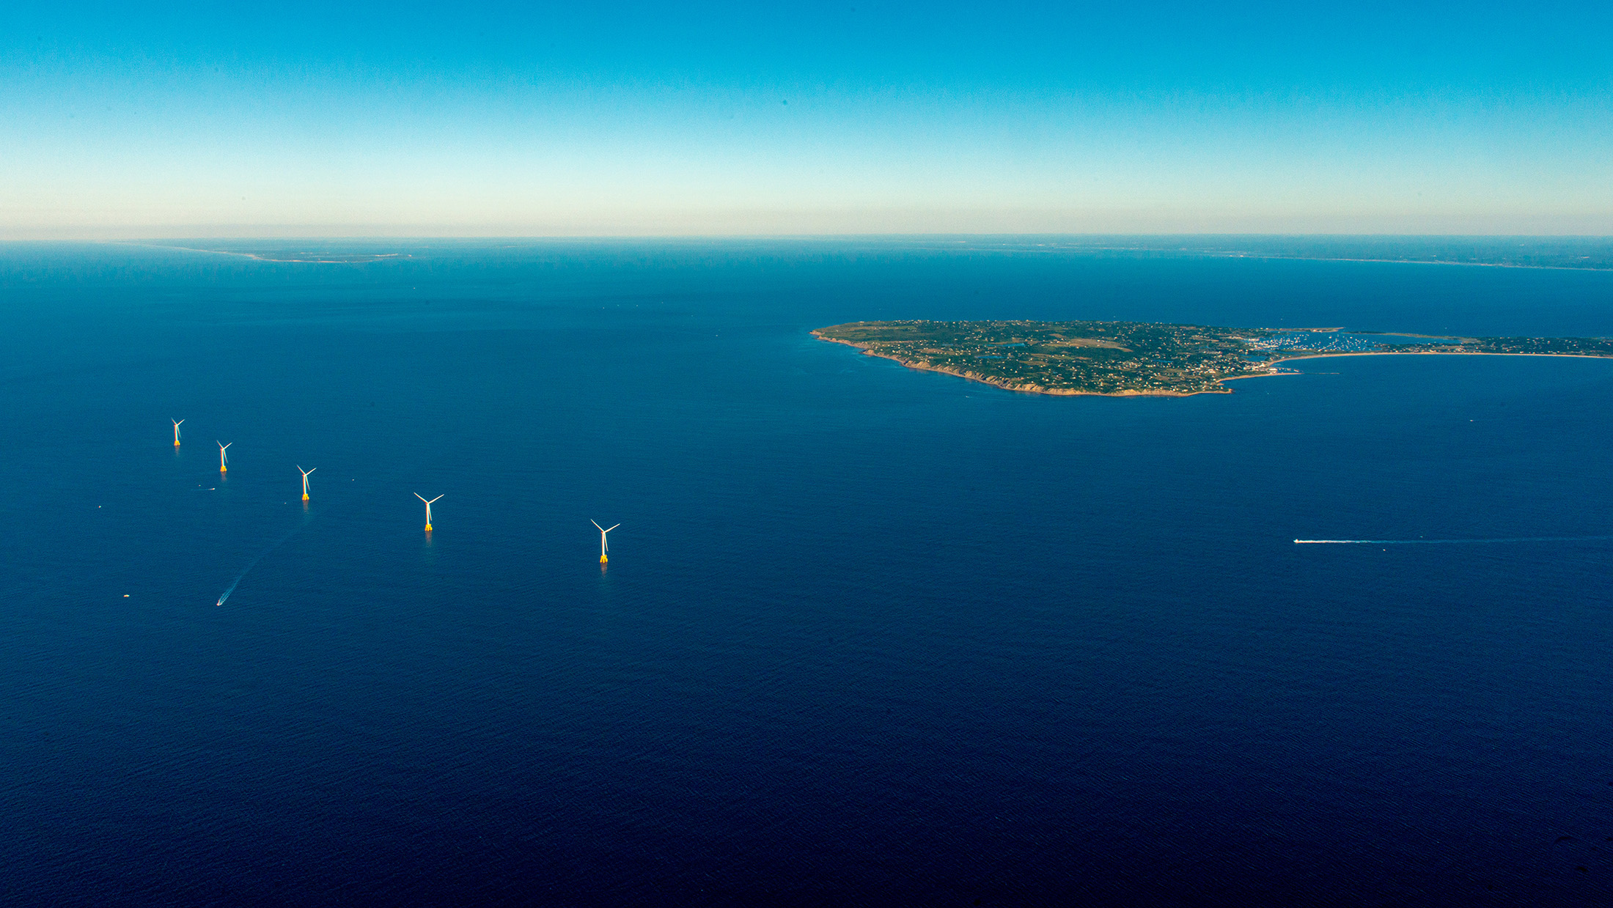
Bureau of Ocean Energy Management
U.S. Outer Continental Shelf Renewable Energy
Photo courtesy Deepwater Wind
Wright Jay Frank
Office of Renewable Energy Programs
Royalty Policy Committee
Planning, Analysis & Competitiveness Subcommittee, Non-Fossils and Renewable Energy Working Group
January 3, 2018

Slide 2
Offshore Wind Energy A Fair Return
“The Secretary shall establish royalties, fees, rentals, bonuses, or other payments to ensure a fair return to the United States for any lease, easement or right-of-way granted under this subsection.”
Outer Continental Shelf Lands Act (OCSLA), 42 USC 1337(p)(2)(A)
Note: OCSLA requires “fair return” for renewable energy leases, and “fair market value” for oil and gas leases.

Slide 3
Offshore Wind Energy A Fair Return
Fair Return
Bonus Bid
Rental
Operating Fee

Slide 4
Offshore Wind Energy The Operating Fee
F | = | M | * | H | * | C | * | P | * | R
Annual Operating Fee |  | Nameplate Capacity (MW) |  | Hours per Year (8760) |  | Capacity Factor (0 to 1) |  | Power Price ($/MWh) |  | Operating Fee Rate (0 to 1)
Simple in principle…

Slide 5
Offshore Wind Energy The Operating Fee
F | = | M | * | H | * | C | * | P | * | R
Annual Operating Fee |  | Nameplate Capacity (MW) |  | Hours per Year (8,760) |  | Capacity Factor (0 to 1) |  | Power Price ($/MWh) |  | Operating Fee Rate (0 to 1)
Generation at continuous full power operation (MWh)

Slide 6
Offshore Wind Energy The Operating Fee
F | = | M | * | H | * | C | * | P | * | R
Annual Operating Fee |  | Nameplate Capacity (MW) |  | Hours per Year (8,760) |  | Capacity Factor (0 to 1) |  | Power Price ($/MWh) |  | Operating Fee Rate (0 to 1)
Anticipated Annual Power Output (MWh)

Slide 7
Offshore Wind Energy The Operating Fee
F | = | M | * | H | * | C | * | P | * | R
Annual Operating Fee |  | Nameplate Capacity (MW) |  | Hours per Year (8,760) |  | Capacity Factor (0 to 1) |  | Power Price ($/MWh) |  | Operating Fee Rate (0 to 1)
Estimated Market Value ($)

Slide 8
Offshore Wind Energy The Operating Fee
F | = | M | * | H | * | C | * | P | * | R
Annual Operating Fee |  | Nameplate Capacity (MW) |  | Hours per Year (8,760) |  | Capacity Factor (0 to 1) |  | Power Price ($/MWh) |  | Operating Fee Rate (0 to 1)
Share (2%) of the estimated market value of the power produced payable to the lessor.

Slide 9
Offshore Wind Energy The Operating Fee
F | = | M | * | H | * | C | * | P | * | R
Annual Operating Fee ($) |  | Nameplate Capacity (MW) |  | Hours per Year (8,760) |  | Capacity Factor (0 to 1) |  | Power Price ($/MWh) |  | Operating Fee Rate (0 to 1)
For phased development, how do you determine how much of the lease is operational?
What’s the capacity factor for the first year? How often does that get updated?
What does “Power Price” mean? The price for where? Over what time period? Real-time or day-ahead price averages?
Shouldn’t “hours per year” change during leap years?
But what appears conceptually simple is inevitably less so “as implemented.”

Slide 10
Offshore Wind Energy The Operating Fee – Lease Addendum B

Slide 11
Offshore Wind Energy The Operating Fee – Lease Addendum B

Slide 12
Offshore Wind Energy Back to First Principles
So, what do we seek from an operating fee?
Policy Objectives:
Fair Return
Not Unduly Burdensome
Simplicity
Predictability
Auditability
Support Offshore Wind’s Strengths

Slide 13
Offshore Wind Energy Proposals
Revisions to consider:
Assess the operating fee retroactively rather than prospectively.
Tie the power price to the actual price that the lessee sells its power for (for example, the power purchase agreement price).
Assess the operating fee as a fixed annual charge, decoupled from predicted or actual generation (e.g., annual fee per MWh sold, or annual fee per MW of nameplate capacity).
Other ideas welcome.

Slide 14
Offshore Wind Energy Implementation
Rulemaking:
The current operating fee is specified in our regulations (30 CFR 585.506), so any changes would require a rulemaking process:
Advanced Notice of Proposed Rulemaking (optional);
Notice of Proposed Rulemaking;
Final Rule
We are planning direct outreach to experts and stakeholders:
Royalty Policy Committee
Listening session(s)
Request for Information
Changes to Addendum B (if they are consistent with the regulations) can be made on a lease-by-lease basis.
Contract (in procurement) to help BOEM implement current regulations, and seek recommendations on simplifying lease language.

Slide 15
Offshore Wind Energy The Ask
What are we asking of the Royalty Policy Committee?
Are there policy objectives other than the ones we have identified that we should include?
Considering our policy objectives, is there a better way to structure our operating fee?

Slide 16
Thank You!
Photo courtesy Deepwater Wind

Slide 17
Contact
Wright Jay Frank
Senior Policy Advisor
Bureau of Ocean Energy Management
www.boem.gov
Renewable Energy Program
www.boem.gov/Renewable-Energy
Wright.Frank@boem.gov

